Slide 1
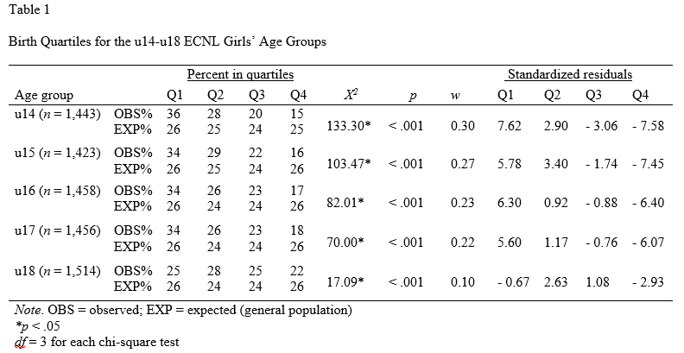
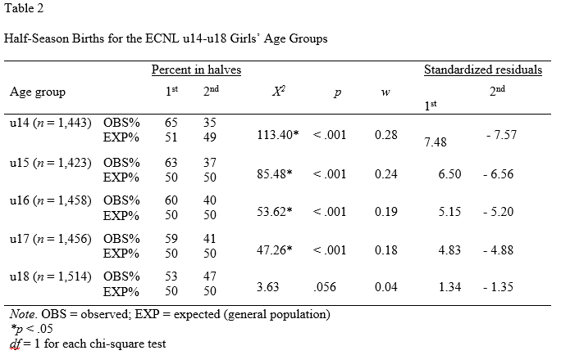
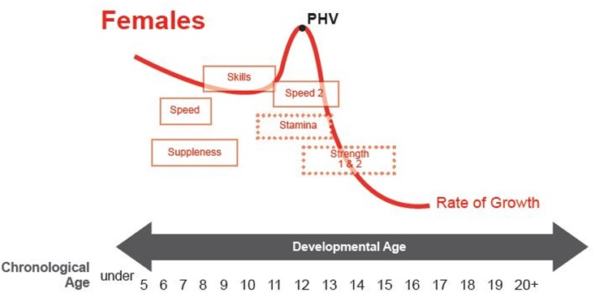
Relative Age Effect Among Elite Youth Female Soccer Players Across the United States
Ajit Korgaokar, Richard S. Farley, Dana K. Fuller & Jennifer L. Caputo
Department of Health and Human Performance,
Middle Tennessee State University, Murfreesboro, TN
Abstract
Introduction:
Relative age effects (RAEs) have been detected in sport when asymmetry in birthdate distribution significantly differs from the distribution of the birthdates of the general population
Consequence of RAEs has been an overrepresentation of athletes born early in the cohort and an underrepresentation of athletes born late in the cohort
Purpose was to determine the existence of RAEs among elite youth female soccer players competing in the Elite Clubs National League (ECNL) during the 2012-2013 season
Methods:
Player birthdates (u14-u18 N = 7,294) collected from the ECNL website and compared to the birthdate distribution for the general population
Results & Discussion:
RAE observed across all age groups (u14-u18)
Overrepresentation of players observed in Q1 and an underrepresentation of players in Q4 among the u14-u17 age groups
Overrepresentation of players detected in Q2 and an underrepresentation of players in Q4 in u18 age group
First and second halves of the playing season showed strong RAEs among the u14-u17 age groups
No statistically significant difference found between the first and second halves of the playing season in the u18 age group
Conclusion:
Female players born toward the end of the selection year are disadvantaged in the ECNL
Future research should focus on key mechanisms that contribute to RAEs in youth soccer
Methodology
Participants
Elite youth female soccer players competing in the u14, u15, u16, u17, and u18 (N = 7,294) age groups in the ECNL during the 2012-2013 season
Procedures
Birthdate for each player was collected from the individual team web pages from the ECNL website
Birthdates of each player were compared to the birthdates of females in the general U.S. population born during the same years as the players
Birthdate range for the 2012/2013 ECNL players is 1992-1999
Census birthdates were collected from the Center for Disease and Control and Prevention (CDC) vital statistics reports.
Birthdates organized into quartiles based upon the ECNL competition year of August 1st – July 31st
Statistical Analyses
Analyses conducted using IBM SPSS predictive analytics software (Version 20; IBM Inc.,USA).
Each age group was analyzed for asymmetry in birthdate distributions. A series of chi-square (χ2) goodness-of-fit tests were used to determine differences between the observed birth months across the playing season (August-July) and expected birth month distributions for the births of females born in the U.S. from 1992-1999 (the same years as the players).
Dependent variable for each analysis was the frequency of soccer players born in each quartile per age group (p < .05)
Chi-square (χ2) values were used to calculate an effect size w statistic to determine the strength of the RAE
Standardized used to determine which observed birthdate quartiles differed from the expected distribution
Results
Statistical difference between the observed and expected quartile distributions for all of the age groups u14-u18
Analysis revealed an overrepresentation of players born at the beginning of the cohort and an underrepresentation of players born at the end of the selection year for all age groups
Standardized residuals showed an overrepresentation of players born in Q1 and an underrepresentation of players born in Q4 for the u14, u15, u16, and u17 age groups.
In the u18 age group, the residuals indicated an overrepresentation of players born in Q2 and an underrepresentation of players born in Q4.
Overrepresentation of players born in the first half of the cohort and an underrepresentation of players born in the second half of the cohort for the u14-u17 age groups
Overrepresentation of players born in Q2 and an underrepresentation of players born in Q4 in the u18 age group.
Purpose
To determine the existence of RAEs among elite youth female soccer players competing in the Elite Clubs National League (ECNL) during the 2012-2013 season
Hypothesis: A significant RAE would be present among this group of elite level youth soccer players, indicating a bias against the selection of soccer players born late in the cohort
Conclusion
Youngest in elite soccer across the U.S. are disadvantaged when organized into cohorts
Future research should focus on key factors contributing to RAEs in youth soccer
Structural changes designed to reduce or eliminate RAEs should be examined, evaluated, and implemented where appropriate

